Slide 1





XT3D multi-point flux approximation
By the MODFLOW Development Team
MODFLOW 6 and FloPy: Take Your Modeling to the Next Level
Princeton, New Jersey, USA
Friday, May 31 – June 1, 2024

Slide 2
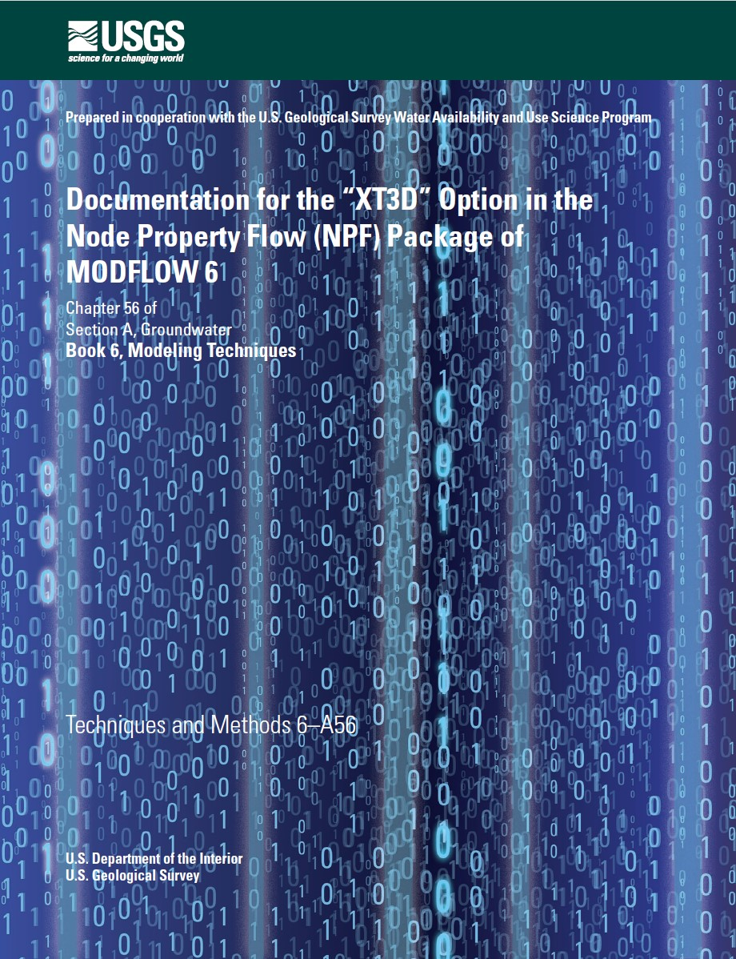

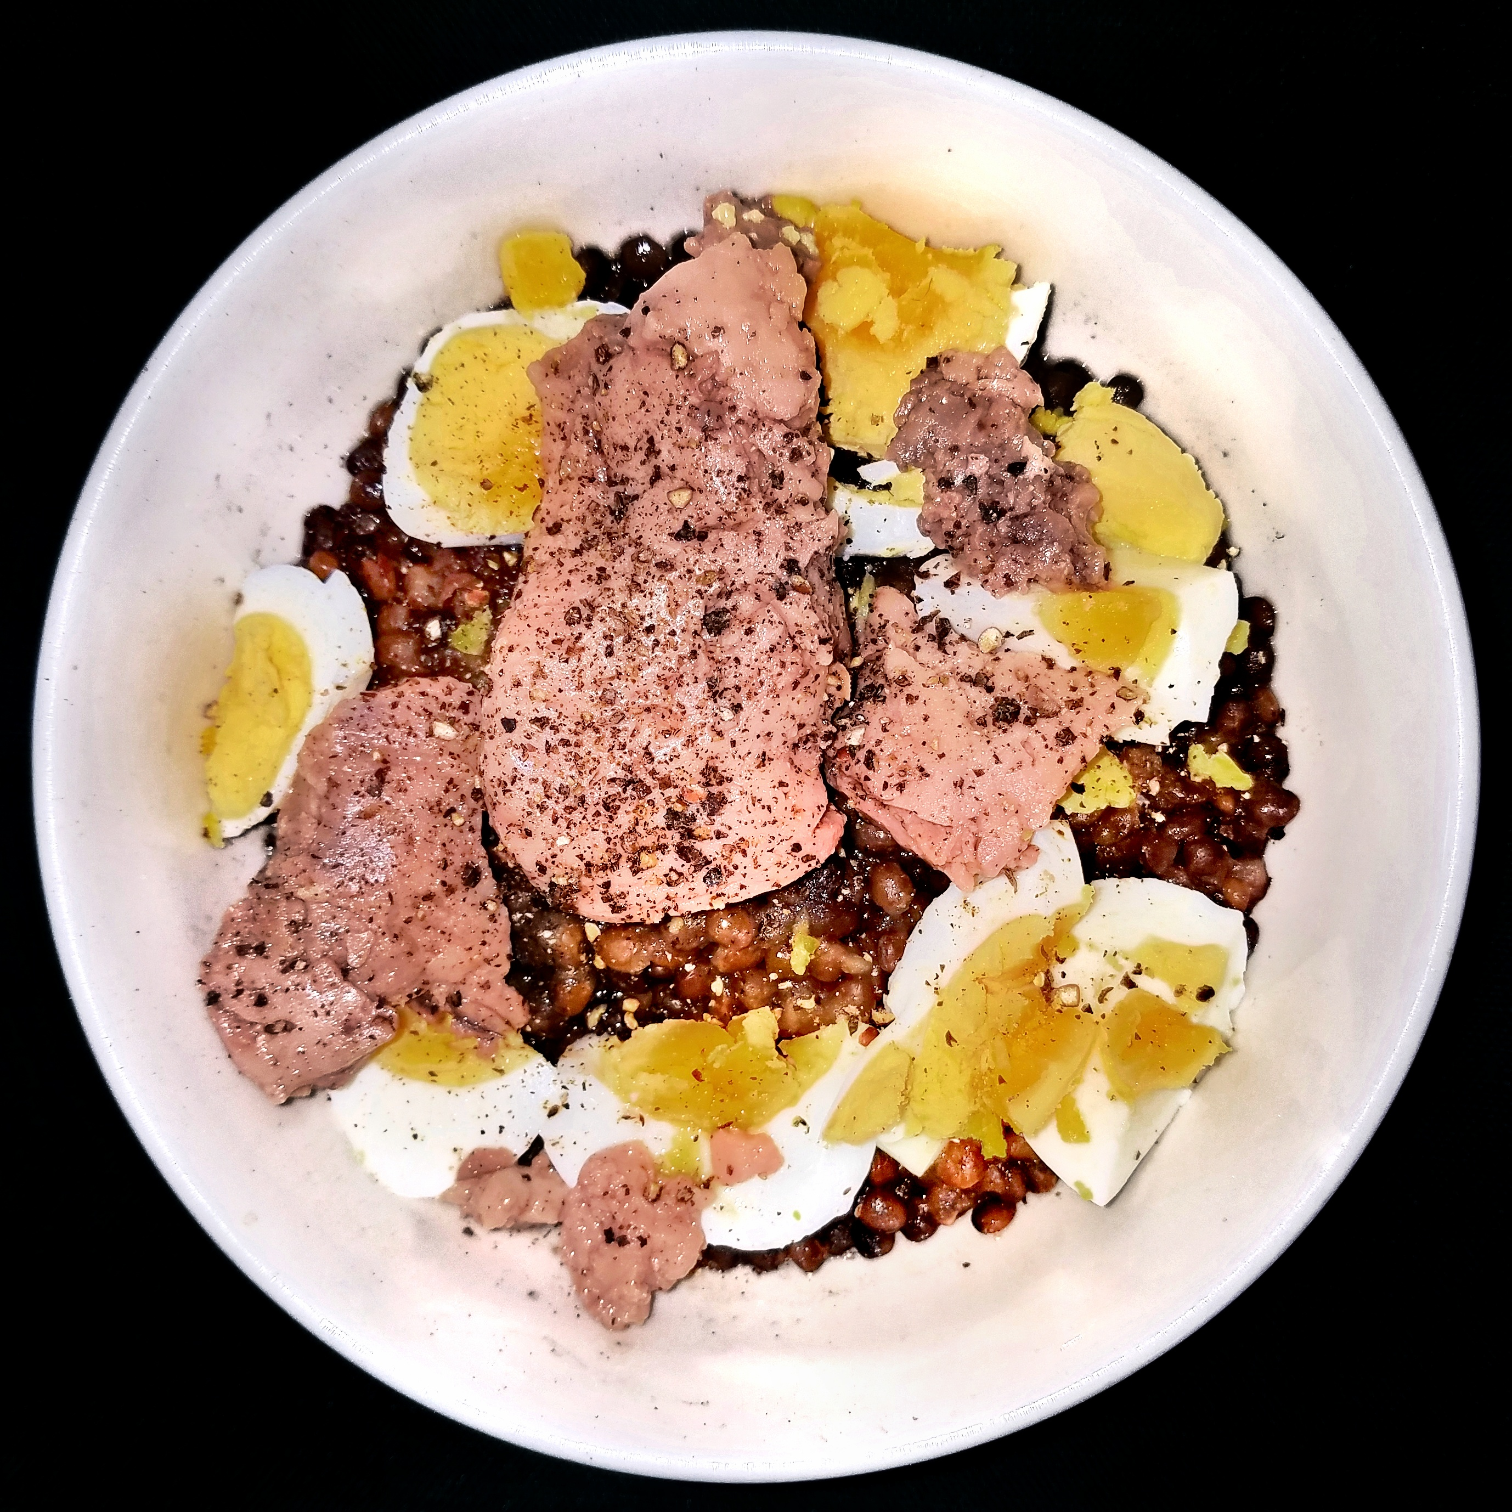
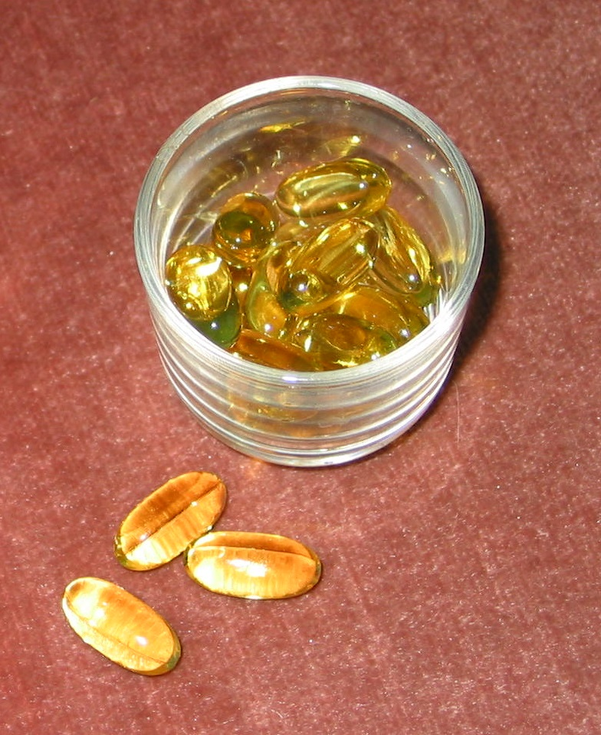
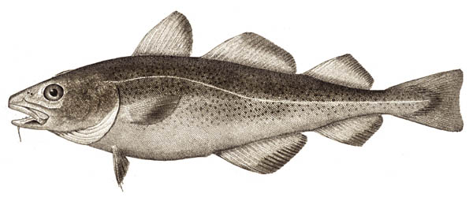

Slide 3

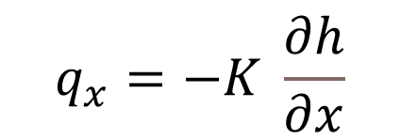
What info do we need? What info do we have?
Darcy’s Law
K isotropic
$$q_{x}=−K \frac{∂h}{∂x}$$
n
m
$$Q_{n,m}=−C_{n,m} \left(h_{m}−h_{n}\right)$$
Standard, conductance-based (two-point)
y
x

Slide 4
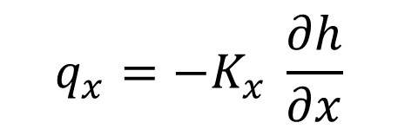
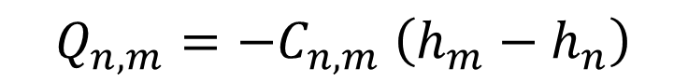
What info do we need? What info do we have?
K anisotropic but grid-aligned
Darcy’s Law
$$q_{x}=−K_{x} \frac{∂h}{∂x}$$
n
m
$$Q_{n,m}=−C_{n,m} \left(h_{m}−h_{n}\right)$$
Standard, conductance-based (two-point)
y
x

Slide 5
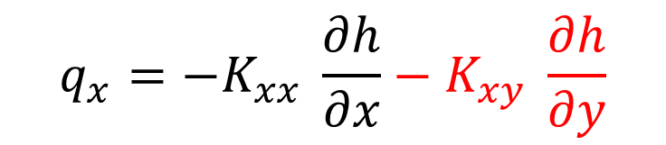
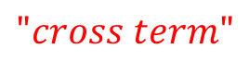
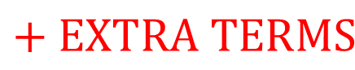
What info do we need? What info do we have?
K anisotropic, not grid-aligned
Darcy’s Law
$$q_{x}=−K_{xx} \frac{∂h}{∂x}−K_{xy} \frac{∂h}{∂y}$$
$$"cross term"$$
n
m
$$Q_{n,m}=−C_{n,m} \left(h_{m}−h_{n}\right)$$
$$+ EXTRA TERMS$$
y
“multi-point”
x

Slide 6
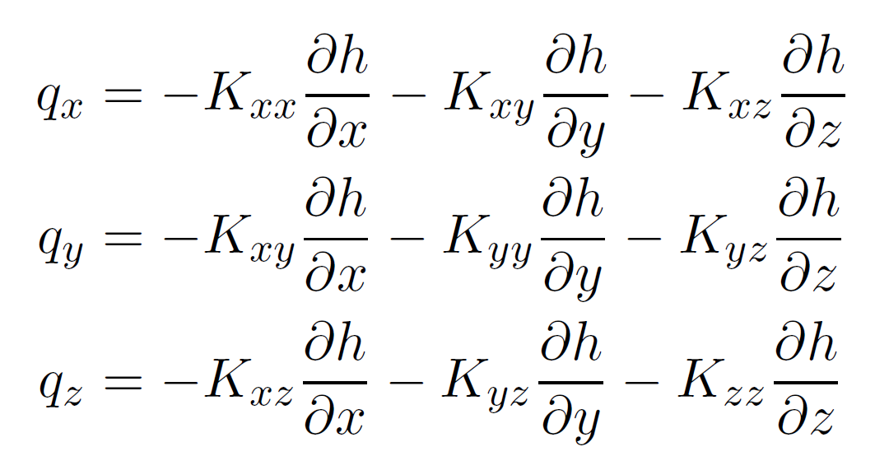
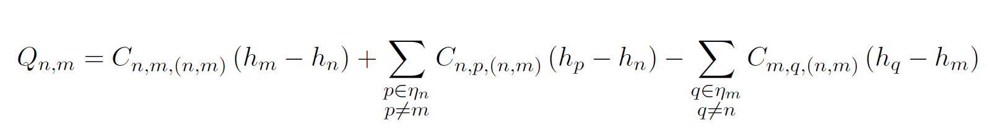
Fully 3D anisotropy on unstructured grid
Darcy’s Law
n
m
XT3D (multi-point)

Slide 7
Before version 6, MODFLOW had only …

Slide 8
Standard, conductance-based formulation
What is it?
Two-point flux approximation – a way of expressing the flow between two cells using only the head values in those two cells
The default groundwater flow formulation in MODFLOW 6
When is it accurate?
Structured (rectangular) grid, or unstructured grid that satisfies the “CVFD requirements,” and
Hydraulic conductivity tensor that’s isotropic, or anisotropic but aligned with the grid
Why use it?
It’s fast
y
x
“TWO-POINT”

Slide 9
With MODFLOW 6 came …

Slide 10
XT3D
What is it?
A multi-point flux approximation – a way of expressing the flow between two cells using multiple, nearby head values to increase accuracy
An optional groundwater flow formulation in MODFLOW 6
Why use it?
Can improve accuracy substantially if you have
an unstructured grid that doesn’t satisfy the “CVFD requirements,” and/or
hydraulic conductivity anisotropy not aligned with the grid
Easy to use – just “flip a switch”
What’s the catch?
More involved calculations = longer runtime
More memory
“MULTI-POINT”

Slide 11
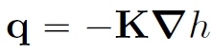
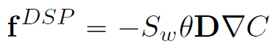
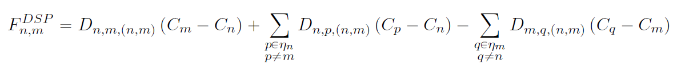
XT3D is also useful for transport (dispersion)
FLOW
TRANSPORT
(Darcy’s Law)
(Fick’s Law)
XT3D can be helpful when there’s anisotropy and/or an unstructured grid
XT3D is almost always helpful because mechanical dispersion almost always involves “cross terms”
XT3D is OFF by default
XT3D is ON by default

Slide 12
Turning XT3D on and off in Flopy
 | FLOW Node Property Flow (NPF) Package | SOLUTE TRANSPORT Dispersion (DSP) Package | ENERGY TRANSPORT Conduction/Dispersion (CND) Package
Turn XT3D on | xt3doptions=“xt3d” or xt3doptions=True | (default; no command needed) or xt3d_off=False | (default; no command needed) or xt3d_off=False
Turn XT3D off | (default; no command needed) or xt3doptions=“” or xt3doptions=False | xt3d_off=True | xt3d_off=True

